Slide 1

VR Gaming Market analysis Presentation
By: Humza Sheikh

Slide 2
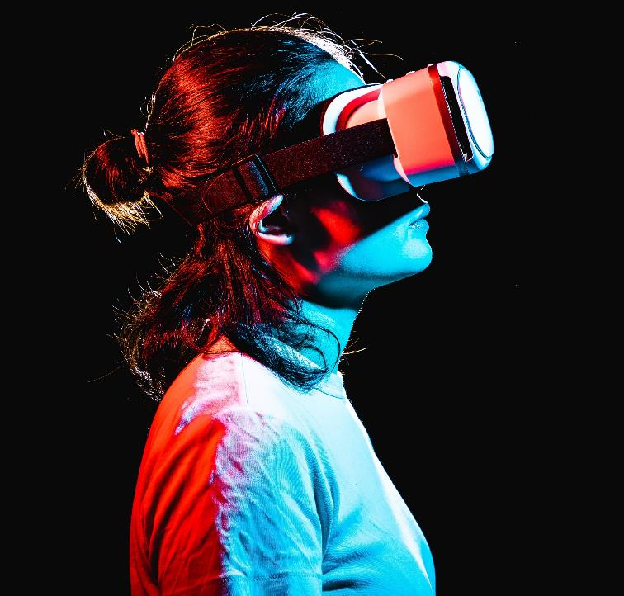
Introduction
This presentation will briefly summarize the market analysis report, focus on the market overview and growth, trends and problems, key player and headsets, and the future

Slide 3
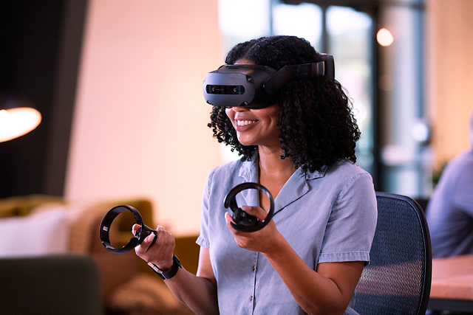
Key Findings
VR gaming market was valued at USD $27.25 billion, and it will keep growing.
By 2028, The market will be valued at USD $130.05 billion.
Current trend is to improve overall hardware and the future trend is to implement brain-computer interfaces (BCIs) and AI
Highlight key players such as Valve and ILM X LAB, companies that have successful creating VR titles
The Oculus/Meta quest 2 and Valve Index are two success headsets
In summary, the VR gaming market is on an upward trajectory, characterized by innovation, user demand, and the significant influence of key players and platforms.

Slide 4
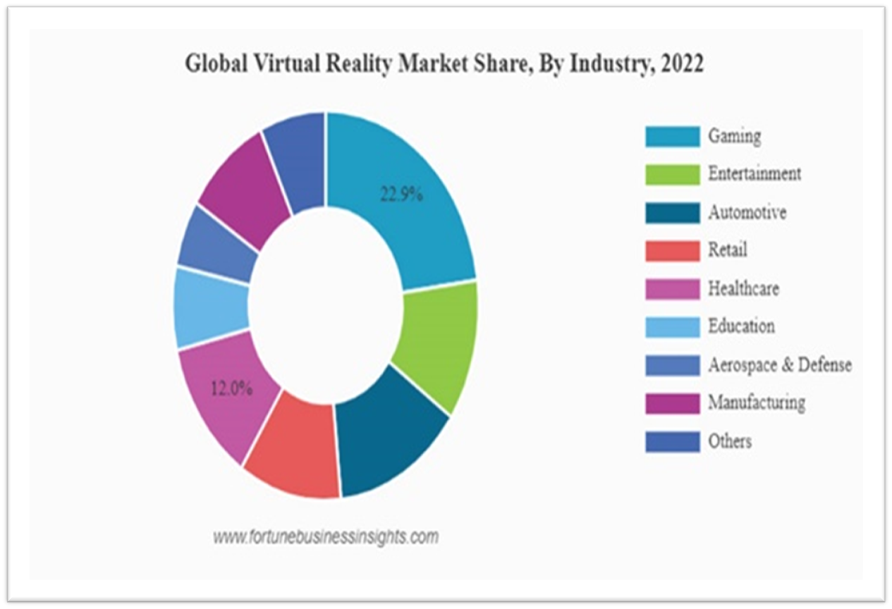
Market Overview and Growth
The gaming sector holds a 22.9% market share in the Global Virtual Reality Market in 2022.
In the same year, the market was valued between $17.25 and $19.44 billion U.S. dollars.
The market will estimate to grow around USD $130.05 billion from 2023 through 2028
The rapid popularity of the VR genre and big companies like Sony, Meta, Microsoft investing heavily in the sector are one of many factors that help grow the market rapidly.

Slide 5
Market tRENDS
The current trend, is to improve the hardware continuously and, at the same time, reduce the price as well as make it more accessible.
Future direction:
developing brain-computer interfaces (BCIs) which allow users to control their VR experiences with their thoughts, eliminating the need for a controller.
integrate AI and machine learning in games.
making stronger effort in accommodating people who have disability with lighter and more comfortable headsets and more accessible software for people with disabilities.

Slide 6
KEY Players
I have highlighted two gaming development companies, if you are interest learning more, check out the full report
Valve Corporation:
- Famous and Well-known titan of the gaming industry for developing and publisher games,
creating steam: the largest digital vendor of video games.
- Famous for the Half-Life, portal, Left 4 dead and many other franchises
- Well-known player in the VR industry and have been successful creating their own
VR headset the index and at the same time collaborating with Hp and HTC on their respective headsets.
ILM X LAB:
- Studio that was founded in 2015 by the biggest visual companies in the business, Industrial light & Magic (ILM), ILM was
founded by George Lucas and the company is responsible for providing outstanding special effect for more than 400 films.
- Dedicated to creating visual stunning, immersive game with their famous Ip’s, Star Wars, Marvel and others.
- Vader Immortal: A Star Wars VR Series and Tales from the Galaxy’s Edge are most notable and successful titles
from the studio.

Slide 7
KEY Players
Here are the top ten gaming development companies in 2023 who have plenty of experiences and success on creating and developing titles that push the industry forward and influence the sector.
Valve Corporation: Half-Life Alyx
Oculus Studios: Jurassic World Aftermath
Cloudhead Games: Pistol Whip
ILMXLAB: Valve Immortal: A Star Wars VR Series
Polyarc: Moss
Survios: Creed: Rise to Glory
Archiact: Doom 3: VR Edition
Schell Games: Among Us VR
Read at Dawn: Lone Echo Series
Fast Travel Games: Vampire: The Masquerade

Slide 8
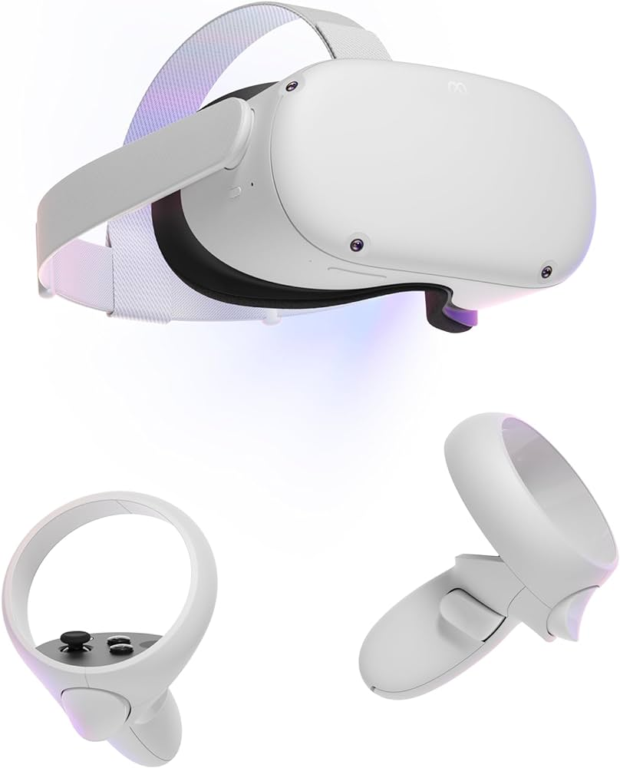
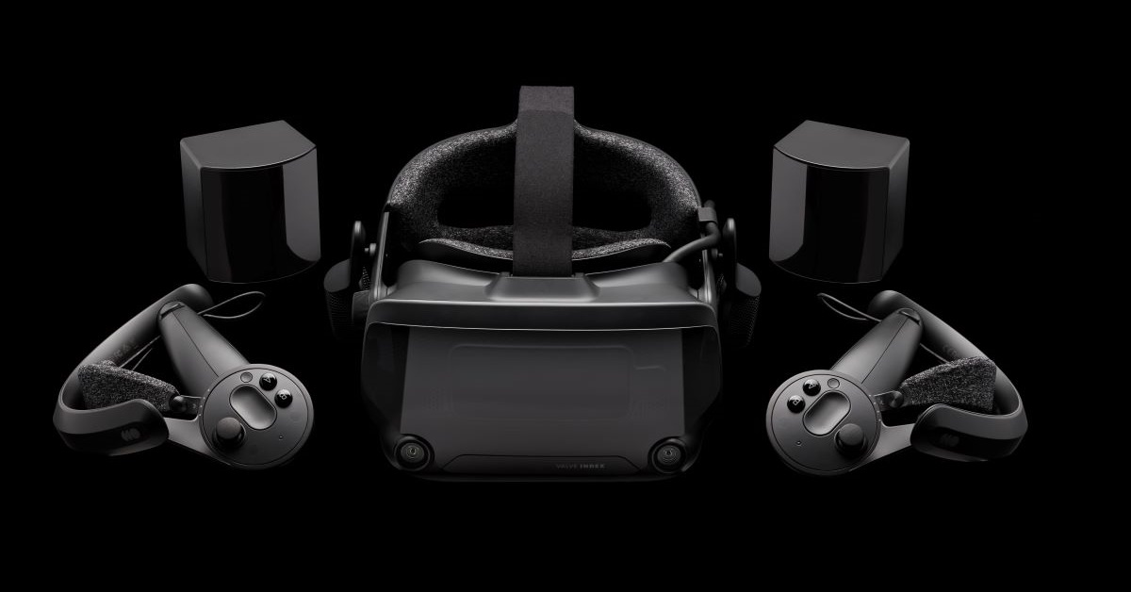
Headsets
Meta/Oculus Quest 2
Valve index
The Meta/Oculus Quest 2 is one the most accessible headsets to start your VR journey.
Because:
it does not require the user to own pc or a console, just an app on your phone.
Includes everything you need out of the box and affordable.
Valve index, Sony PSVR2, and HP Reverb G2 are great options, each with their own pros and cons.
Index is an excellent headset if you want a much more powerful headset without breaking the bank.
VAR labs have plenty of experience with the Index and Steam by developing their learning simulators.

Slide 9
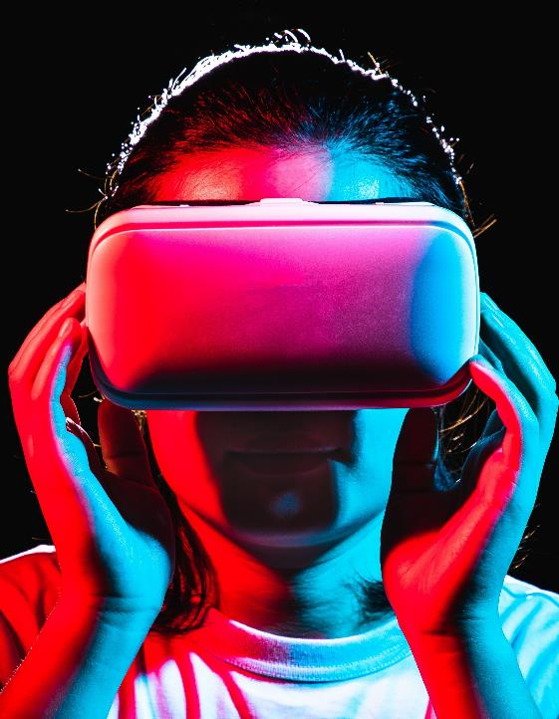
The Future/Summary
The future looks promising, focusing on making the headset more affordable over time and accessible.
The constant evolution of the hardware and immersive titles will be the main driving force in growing the sector.
In summary, the VR gaming market is on an upward trajectory, characterized by innovation, user demand, and the significant influence of key players and platforms.
VR gaming promises an exciting future with immersive experiences and boundless possibilities for gamers.

Slide 10
Key Findings
VR gaming market was valued at USD $27.25 billion, and it will keep growing.
By 2028, The market will be valued at USD $130.05 billion.
Current trend is to improve overall hardware and the future trend is to implement brain-computer interfaces (BCIs) and AI
Highlight top ten gaming development companies in 2023 that pushed the industry forward.
The Oculus/Meta quest 2 and Valve Index are two success headsets
In summary, the VR gaming market is on an upward trajectory, characterized by innovation, user demand, and the significant influence of key players and platforms.

Slide 11
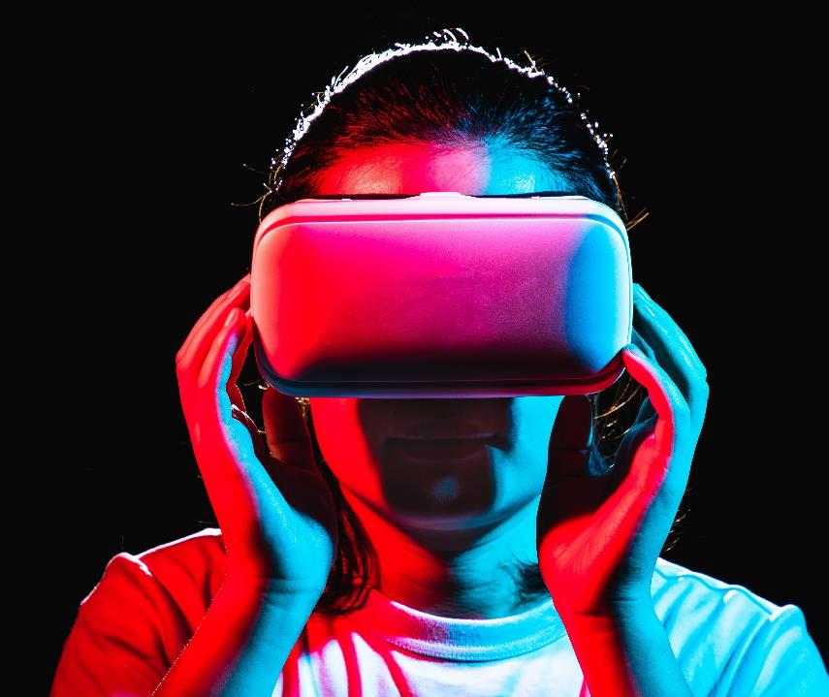
Thank you
Humza Sheikh​​
Project Assistant
hnsheikh@conestogac.on.ca

Slide 12
References
Market Overview and Growth:
Expert Market Reasearch . (n.d.). Global Virtual Reality Gaming Market. Retrieved from Expert Market Reasearch : https://www.expertmarketresearch.com/reports/virtual-reality-gaming-market#:~:text=The%20global%20virtual%20reality%20gaming,USD%20130.05%20billion%20by%202028.
Market Trend:
​Full Scale . (2023, May 18). 2023 Virtual Reality Development Trends: The Future Is Now. Retrieved from Full Scale : https://fullscale.io/blog/virtual-reality-development-trends-2023/#:~:text=Some%20of%20these%20hardware%20improvements,%2Dcomputer%20interfaces%20(BCIs).
Full Scale. (2023, May 18). Full Scale. Retrieved from 2023 Virtual Reality Development Trends, The Future is Now: https://fullscale.io/blog/virtual-reality-development-trends-2023/#:~:text=Some%20of%20these%20hardware%20improvements,%2Dcomputer%20interfaces%20(BCIs).
Key Players and Headsets:
Vionix . (2023, May 19). Top 10 VR game development companies in 2023. Retrieved from Vionix : https://vionixstudio.com/2023/05/05/top-10-vr-game-development-companies-in-2023/#Valve_Corporation
Will GreenWald, J. M. (2023, October 27). The best VR Headsets for 2023. Retrieved from PC mag: https://www.pcmag.com/picks/the-best-vr-headsets

